Slide 1
Inha University in Tashkent
Theme 6: Philosophy in Modern and Contemporary Periods

Slide 2
Outline:
The Timeframe of Modern period
European Renaissance and Its Legacy
Western Scholars on Astronomy and Philosophy in Modern Period
Philosophical Schools and Traditions in Contemporary Period

Slide 3
Periodization
Modern period is the timeframe of world history, immediately following the Middle Ages and preceding the Contemporary era. The period can be broken into two stages:
1. The early modern period (early 16 - mid-18 centuries)
  European Renaissance
  The Age of Discovery
  The Protestant Reformation
2. The late modern period (mid-18 century – 1945)
  The Age of Enlightenment
By-turn, Contemporary period begins in 1945 and covers historic events which relevant to the present time. It should be noted that some scholars include Contemporary period in Modern era as a third period.

Slide 4
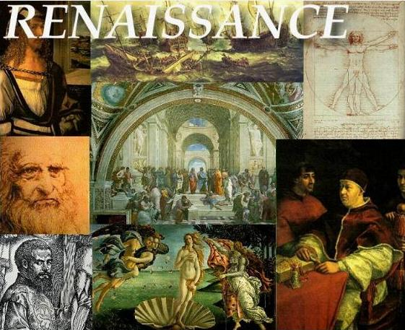
European Renaissance
Renaissance is the era of cultural and ideological development which took place in Western and Central Europe.
The main distinctive features of the Renaissance are:
- secularism
- a humanistic world view
- appeal (an attempt to reestablish) to the ancient cultural heritage, a kind of "revival", “rebirth” of it
The culture of the Renaissance was considered the transition period from the Middle Ages to the Modern era, as the bridge.
The question of the chronological boundaries of the Renaissance is complex (in Italy - XIV-XVI centuries, in other countries - XV-XVI centuries).

Slide 5

The Legacy of European Renaissance
The philosophical thinking of this period can be characterized as anthropocentric.
The intellectual basis of the Renaissance was based on
- humanism
- the rediscovery of classical Greek philosophy, such as that of Protagoras, who said that "Man is the measure of all things."
This new philosophical approach was well expressed in art, architecture, politics, science and literature.

Slide 6
The Legacy of European Renaissance
In the Renaissance, the individual acquires much greater independence.
Hence the new self-consciousness of man and his new social position:
  pride and self-assertion
  the consciousness of human own strength and talent
  These two factors became the distinctive qualities of a person.
Man becomes:
  the creator of himself
  man, no longer needs divine grace for his salvation
  He is the creator of his own life and destiny
  man is the unlimited lord over nature

Slide 7
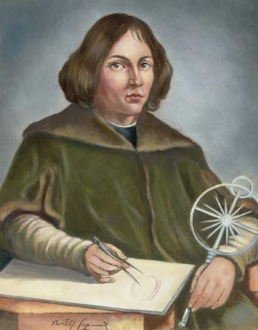
Nicolaus Copernicus
The scientist Nicolaus Copernicus (1473-1543), one of the greatest thinkers of the Renaissance
Contributed most to philosophy, especially astronomy.
He was born in Poland.
The famous work of Nicolaus Copernicus – “On the Revolutions of the Celestial Spheres” which was written just before his death in 1543 was a major event in the history of science.

Slide 8
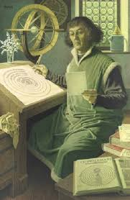
The Theory of Copernicus
Copernicus was famous for his philosophy of heliocentrism (representing the Sun as the center of the universe), which made fundamental changes in science.
In his time, the geocentric system of the universe was considered to be generally accepted, with the Earth in the center and a complex system of orbits around it, proposed by Ptolemy about 1500 years earlier.
After studying the motion of the planets, Copernicus developed the heliocentric theory of the universe. The great discovery of Copernicus was a major achievement in natural sciences.
This discovery scientifically proved inconsistency and the weakness of Christian doctrine on the structure of the world.

Slide 9
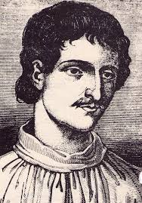
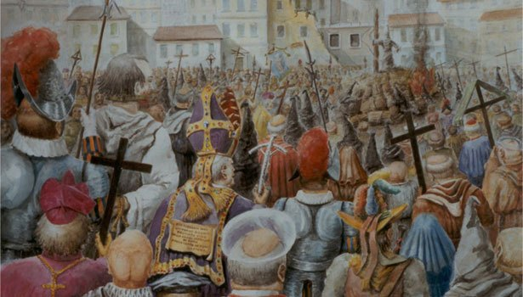
Giordano Bruno
One of the most influential thinkers is Giordano Bruno (1548-1600).
He was born near Naples, Italy.
For his advanced ideas, Bruno was blamed for heresy and expelled from the church.
He had to run away from Italy. He has been in exile for a long time in Switzerland, France, England and Germany.
In 1592 Bruno returned to Italy but was arrested and imprisoned by the Church Inquisition.
In spite of the torture, he did not abandon his doctrine, and in the end, he was sentenced to death, burned in 1600 in Rome.
Bruno supported heliocentric theory.

Slide 10
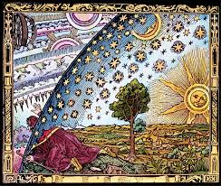
The Impact
He took a number of important theoretical conclusions, taking into account the naturalist experience, that he enriched philosophy even more.
According to Bruno's teachings, true philosophy must be based on scientific experience. He opposed the scholastic doctrine.
He believed that the universe is unique, material, infinite and eternal.
Many of the worlds are out of the solar system. Our planet is the smallest part of the universe. Stars are the sun of other planets.
The Earth is a small particle of the infinite world.

Slide 11
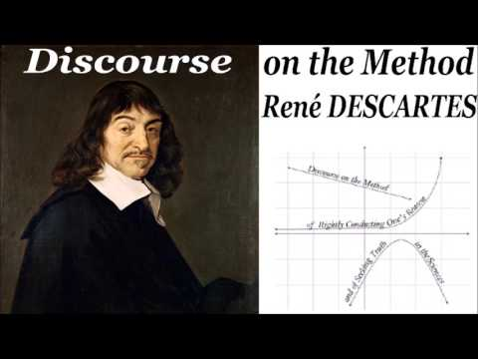
Western Philosophy in the 17th Century
In the 17th century, many of the most significant philosophers in Europe were also engaged in mathematics.
In France, René Descartes and Blaise Pascal made major contributions to mathematics, as did Gottfried Leibniz in Germany.
They believed that the method of reasoning provided the best model for acquiring the knowledge.
Therefore, they were considered as the followers of rationalism.
According to their view, the knowledge comes from reason alone. This became the predominant belief in continental Europe for the next century.

Slide 12
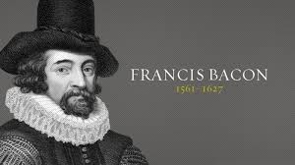
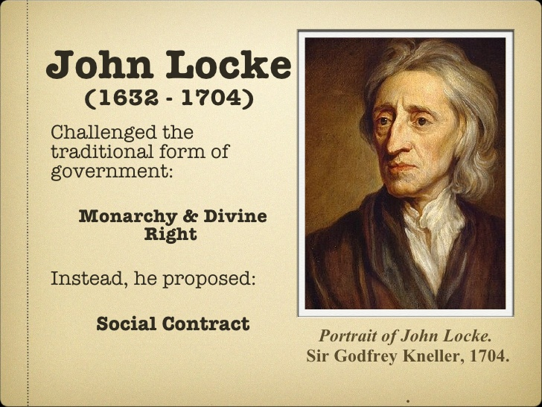
The Development of Philosophical Thoughts in Britain
At the same time, a very different philosophical tradition was emerged in Britain.
On the basis of their investigations Francis Bacon, John Locke came to the conclusion that our knowledge of the world comes not from reason, but experience. This view, known as empiricism, characterized British philosophy during the 17th and 18th centuries.
Despite the division between continental rationalism and British empiricism, both had in common the placing of the human at their centers:
it is human being whose reason or experience leads to knowledge.

Slide 13
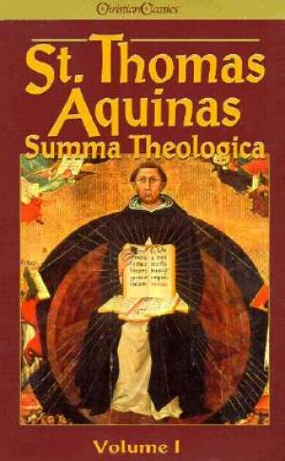
Neo-Thomism
Neo-Thomism (Neo-Scholasticism) is the largest religious and philosophical tradition of Modern and Contemporary periods, which rebuilt Thomas Aquinas's teaching in the Middle Ages (XIII century).
It refers to Thomas Aquinas's new, modern doctrine. According to this doctrine, there should be complete harmony between science and belief. They fill one another, both of which are God's truth.
Neothomists state that beliefs should be applied where there is no knowledge. But this belief should be accepted, not just faith, but also a logical perception. The philosophy of God must be proven by various logical means. Thus, philosophy is to serve religion.
According to Neothomists view, the universe, society are created by God, and society's progress is based on God's will.

Slide 14

Hermeneutics
Hermeneutics (the term was derived from Greek word, "art of interpretation") is the theory of interpretation and understanding of texts, including texts of classical antiquity.
It is the one of the philosophical traditions that emerged in the XX century. The theorist and practitioner in the field of biblical (theological), philosophical or philological interpretation are the followers of hermeneutics.
Although the myth of Hermes, most likely, has nothing to do with the notion of "hermeneutics," but it is also sometimes associated with the idea of hermeneutics.

Slide 15
The term hermeneutics was used most often in relation to biblical texts, then in the meaning of the doctrine of restoring the original meaning of literary monuments, incomprehensible without comment, and also in the meaning of the interpretation of any work (this includes, for example, the authors' explanatory publications) . In this sense, hermeneutics is a discipline of philological criticism.
Hermeneutics, therefore, focuses on the ideas of understanding, explanation, analysis. Society is based on the dialogue, the communication between people. During the dialogue, cultural, historical and scientific values are created.

Slide 16
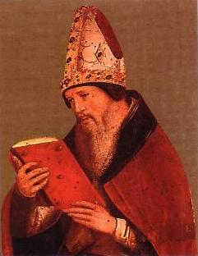
The main purpose of philosophy is to seek out the essence and meaning of life in a dialogue between people.
According to followers of this tradition, the correct analysis of any historical source depends on the full understanding of characteristics of taken period by researcher.
The author of the first generalizing work on hermeneutics was the Christian thinker Aurelius Augustine (354-430). His work was called "Christian Science, or Foundations of Sacred Hermeneutics and the Art of Church Oratory“
There are many supporters of this doctrine in modern times.

Slide 17
Thank you for your attention!

